Slide 1


Asansol Engineering College
Joinode - Code Editor
Guided by : Mr. Santu Mondal
Presented By
Pallavi Kumari (10800220068)
Akanksha (10800220002)
Nikunj Ranjan (10800220044)
Suraj Kumar (10800220054)
Department of Information Technology

Slide 2
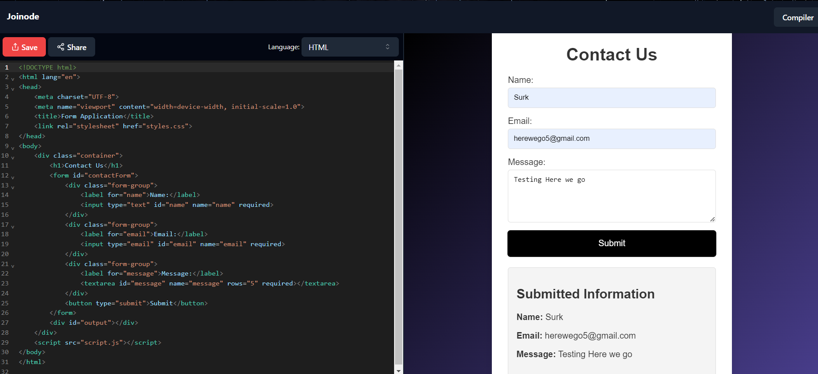
WHAT IS JOINODE?
Joinode contains an interface where user can code in HTML, CSS & JavaScript.
Result will be displayed in the Output Screen within the platform.

Slide 3

What is a Code editor?
A code editor is a specialized text editor designed specifically for writing and editing code.
Features of a Code Editor includes:
Syntax Highlighting
Autocomplete
Error Checking
Code Folding

Slide 4
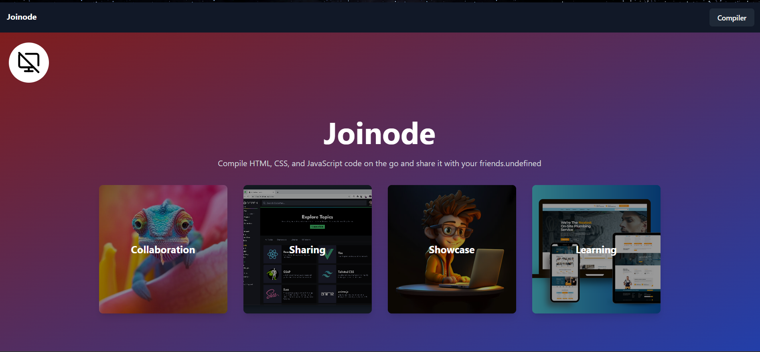
USER INTERFACE
This is the homepage of the website.
User can click on the compiler button to move to the Code Editor .

Slide 5
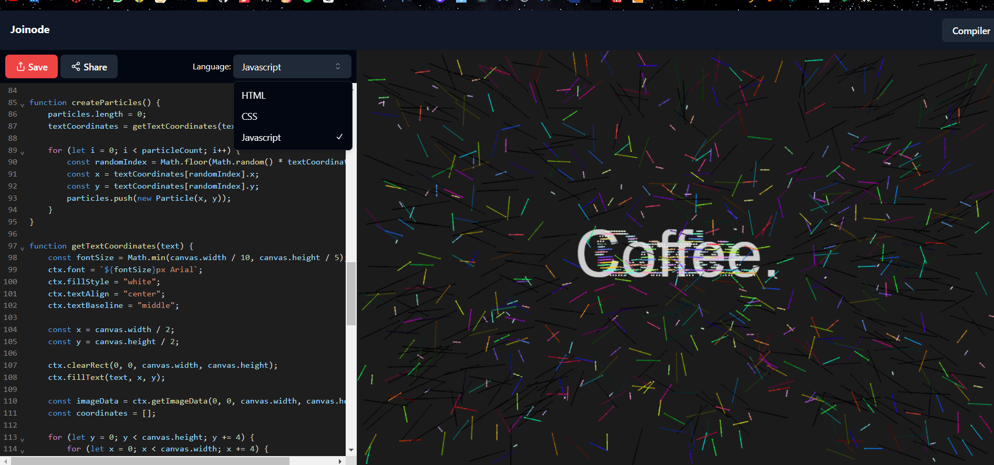
USER INTERFACE
On left side:
User can switch between these languages.
On right side:
Live preview for the input code will be displayed.

Slide 6

KEY FEATURES
Code Editing
Code Suggestions
Resizable Editor
User can save the code
User can share the code

Slide 7
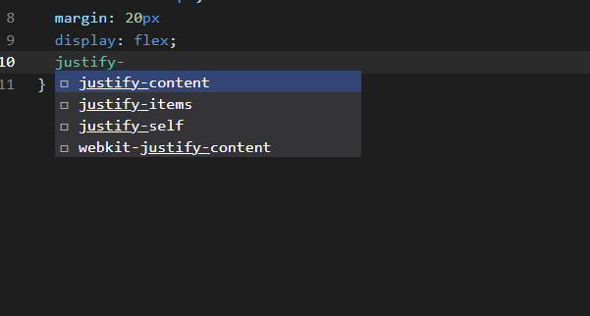
USER INTERFACE
This is how Code suggestion looks like.
Tries to auto complete.

Slide 8
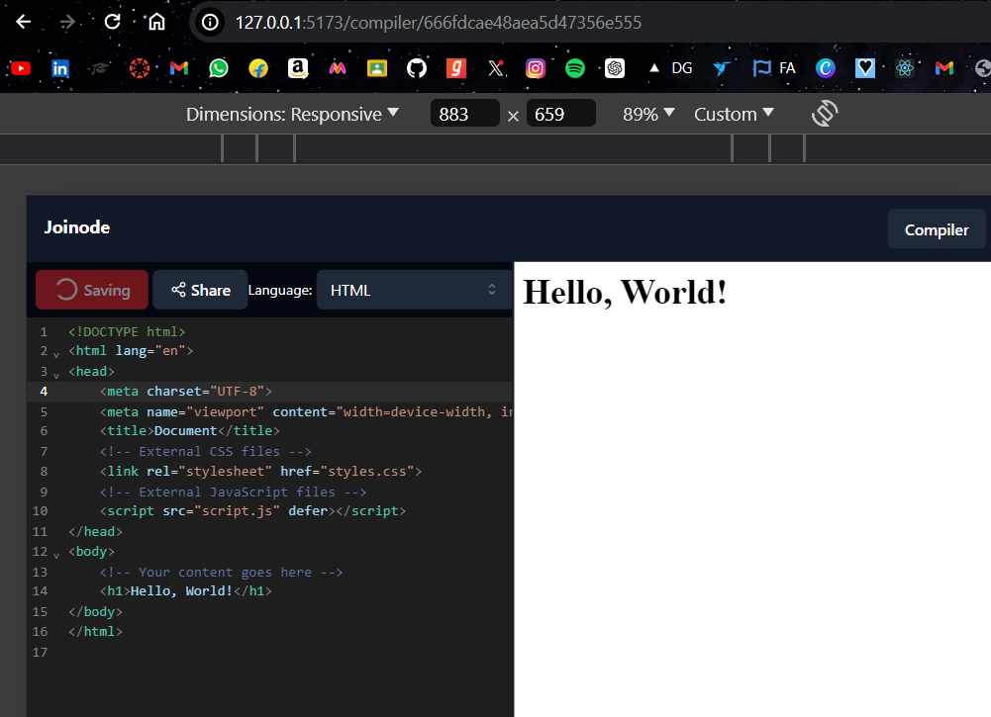
USER INTERFACE
This is how Saving Code looks like
User can simply click on the save button to save the code in Database

Slide 9
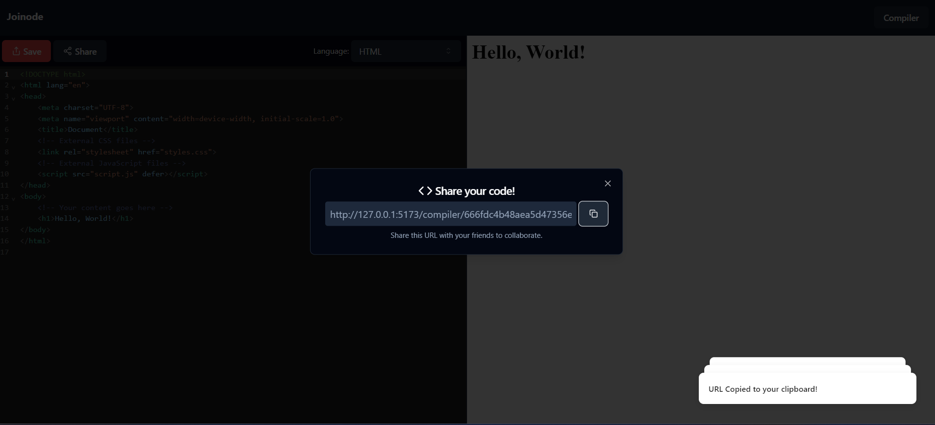
USER INTERFACE
This is how Sharing Code looks like.
User can simply click on the share button.
User will get unique URL which he can copy to share with anyone.

Slide 10
TOOLS AND FRAMEWORK
Following Tools, Library & Frameworks used in our project :
React
Typescript
Tailwind CSS
Codemirror
Redux
Shadcn UI Library

Slide 11



React
React.js is a JavaScript library for building user interfaces.
Codemirror
It contains a inbuilt editor having lots of other functionalities
Redux
Every component in the application can then directly access the required state from that store.

Slide 12

Shadcn UI Library
We have used Shadcn Ui library as an alternative of MUI or other UI libraries.
Optimized library Because it does not add all the components at the same time.

Slide 13
BACKEND AND DATABASE
MongoDB:
Secure data storage management system for the Joinode.
Help the admin to check the database manually.
Express:
This functionality allows developers to map different HTTP methods.
Enable Routing in the application.

Slide 14

FUTURE SCOPE
Authentication
Cutomizable Themes
Including Folders and files

Slide 15
Thank You

